Slide 1
One note Chords
Ben Hartman

Slide 2
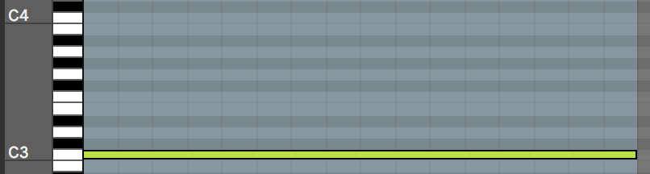
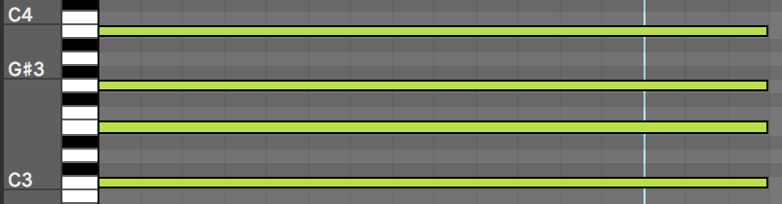
The Project
Create a project that turns single note input MIDI into triad and seventh chord outputs
Switch between different qualities of chords
Use real time MIDI input

Slide 3
Purpose
Make playing chord progressions easier for non-piano players
Speed up workflow

Slide 4
Start
Open MIDI Device, Input, + Output
Storage: Chord
User Input: What Quality of Chord (1-8)?
Enter Loop
Storage: MIDI IN
Retrieve MIDI Input
Enter Loop
Add Chord intervals to MIDI Input + Output Result
No
Has output been produced?
Yes
Exit Loop + Close MIDI input + output

Slide 5
Setting Up
Requires PortMIDI to be installed
Requires MIDI input device
Input + Output device must be defined at the top of page
Specific MIDI Controller inputs and outputs need to be redefined at top of program

Slide 6
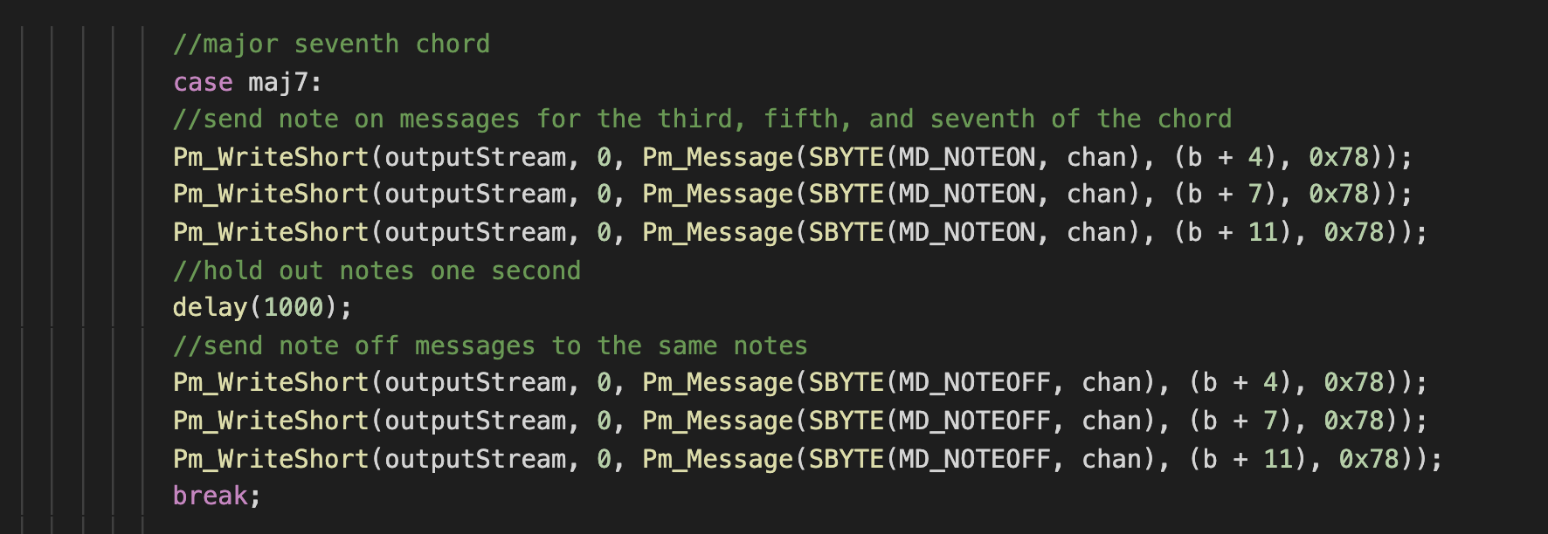
Demonstration

Slide 7
What Works?
MIDI Input
Chord selection and calculation
MIDI Output

Slide 8
What lies in the future for this little baby program?
Split into multiple files
MIDI Device selection
More efficient chord calculations
Replay chords multiple times
Stop loop with keyboard
Modal chords

